Slide 1

God’s Reconstruction
2
+
2
+
Transformation: from Insane to Sane

Slide 2
What is a Worship Service?
NOT:
by the mercies of God:
2
+
“I urge you, brethren by the mercies of God:
present your bodies a living and holy sacrifice,
acceptable to God,
which is your spiritual service of worship.”
Notes:
We begin by asking this question…
Which USUALLY means “in search of the SUBLIME”
** But NOT this! MC Escher = Has it Right
SINKING CATHEDRALS all over Europe
**RATHER…

Slide 3


“And be not conformed
2
+
Your spiritual service of worship:
2
+
to this world”
Notes:
“Spiritual Service” = FORMIDABLE Challenge
“~B Conformed…”
“World System” TOWERS Above Us All
Like a BEAST
No Questions Allowed

Slide 4
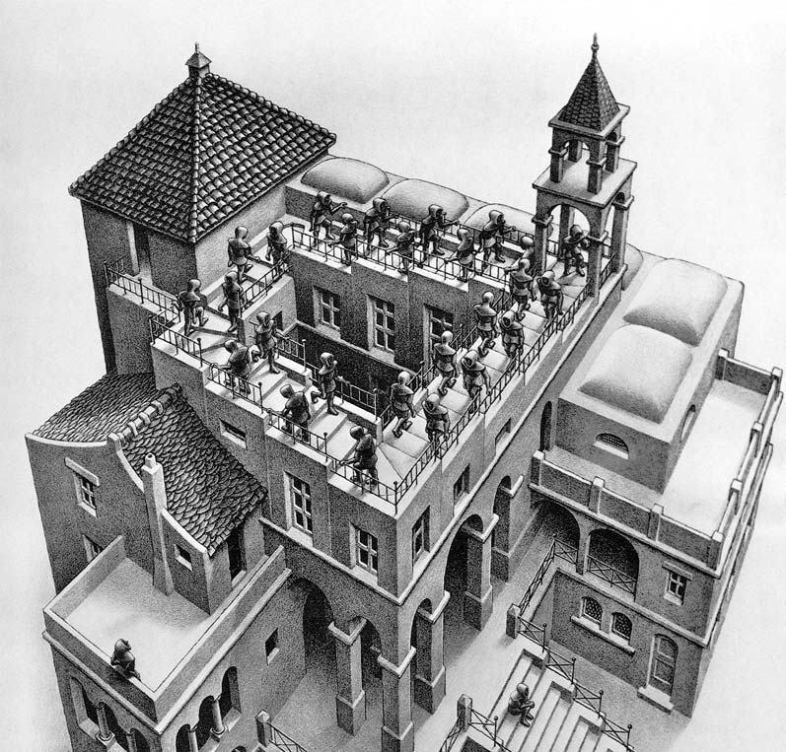
“And be not conformed
2
+
Your spiritual service of worship:
2
+
to this world”
“by the mercies of God”
Notes:
Where Everyone Follows Everyone Else
Like MCE’s “Ascending/Descending”
But They’re Going NOWHERE
AP: Ur Spiritual Serv. Worship =
** STEP BACK & See What’s Going On
“By the Mercies of G” = G’s Effect On Us

Slide 5
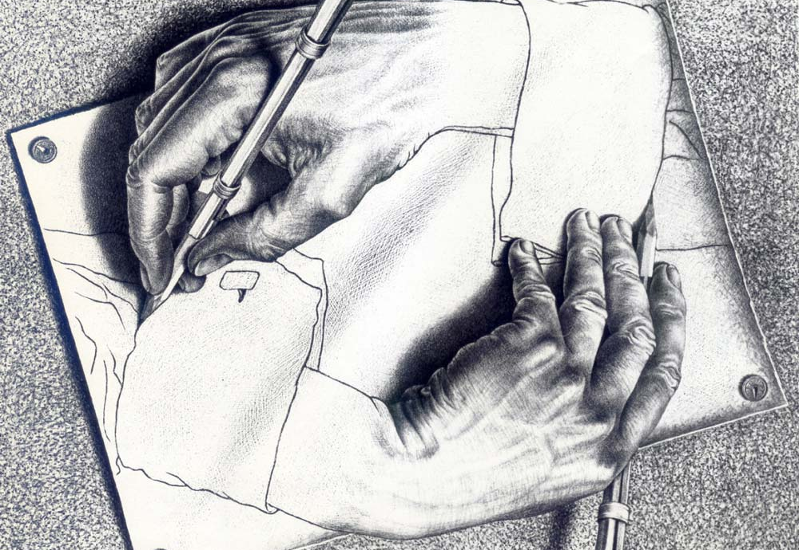
“Rather: be Transformed
2
+
2
+
by the renewing of your mind,
so that you may prove what the will of God is:
that which is good and acceptable and perfect.
“Your spiritual service of worship”
Notes:
MCE’s “Drawing Hands…” = Captures the Idea
Of “Ur Spiritual Service of Worship”
Each Hand is Drawing The Other Hand
FROM: a 2-Dimensional UNREAL World
INTO: a 3-Dim. REAL World
G=Working THRU ME→Transforming U & Vice-Versa
BUT: Transf. is ~Drawing Pictures → it’s **RENEWING
**OUTCOME= PROVING Will of G…
= 2 Urself / 2 Me / 2 ONLOOKERS

Slide 6
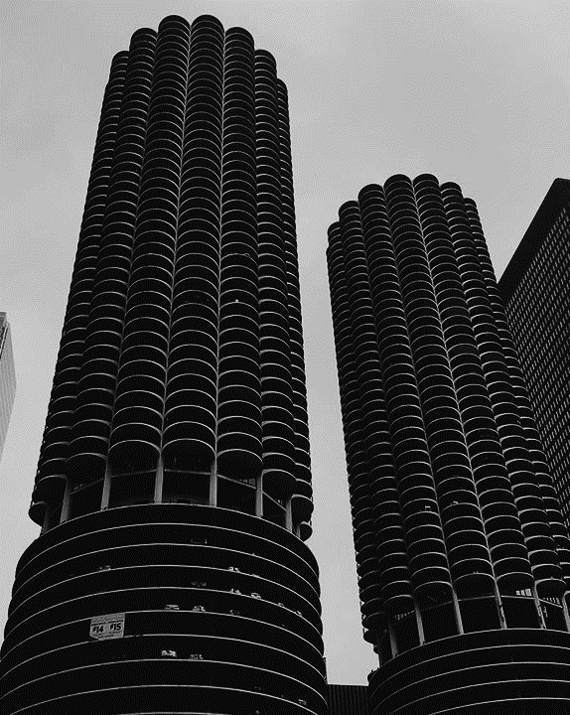
“Be Transformed”
2
+
For through the grace given to me I say to everyone among you:
not to think more highly of himself than he ought to think
Conformed
Thinking “highly of myself” drives the world:
Economy
Technology
Politics
Wars
Notes:
“Transformed” = 2 Parts: #1= “NOT 2 think…”
** = CONFORMED
**Drives the WORLD: **Econ=ADS: “U Desrv”
**Technol= “Selfies/Likes” **Politics= TRUMP
** WARS = “Who’s Better?”
PC Ethics = “Not Allowed 2 Disagree”

Slide 7
“Be Transformed”
2
+
For through the grace given to me I say to everyone among you:
not to think more highly of himself than he ought to think
The Radical, New Ethos of Western Culture:
2 Timothy 3:1-2 But realize this, that in the last days difficult times will come. For men will be lovers of self, lovers of money, boastful, arrogant, revilers, ungrateful…
The Radical, New Ethos of Western Culture:
Matthew 24:12 "Because lawlessness is increased, most people's love will grow cold.
Notes:
Western Cultr=the ENVY of the WORLD → Spreading Globally
2Tim. = New Phenomena
Europe / Russia / China / India / Africa
THUS: **Mt.24:12

Slide 8
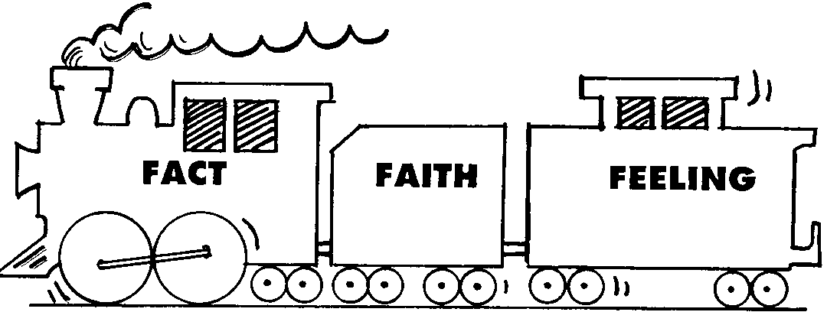
“Be Transformed”
Feelings Oriented
“My heart of hearts…”
“Do you feel me?”
“Happiness is the truth!”
“How can it be so wrong if it feels so right?”
2
+
For through the grace given to me I say to everyone among you:
not to think more highly of himself than he ought to think
Supposed to be:
Conformity:
Feelings
Facts
Faith
Facts
Feelings
Notes:
INCLUDES: **Feelings-Oriented
= **INVERSION of Faith Train
**Supposed 2 b

Slide 9
“Be Transformed”
We are fallen & flawed
We are finite
We are biased/ deceived
2
+
For through the grace given to me I say to everyone among you:
not to think more highly of himself than he ought to think
Notes:
3 Reasons: ** Fallen **Finite **Deceived
=IRREFUTABLE → AP: Why Do We Trust RSelves

Slide 10
“Be Transformed”
2
+
For through the grace given to me I say to everyone among you:
not to think more highly of himself than he ought to think
but to think so as to have sound judgment, as God has allotted to each a measure of faith.
Begins with how you view yourself
Conformed
Transformed
Notes:
** #1 = Conformity
** #2 = TRANSFORMED
**View Urself = IMPORTANT
Self-Obsessed = PROBLEM
“Examine Yourselves..” P. Says

Slide 11
“Be Transformed”
2
+
For through the grace given to me I say to everyone among you:
not to think more highly of himself than he ought to think
but to think so as to have sound judgment, as God has allotted to each a measure of faith.
“Sane”
What really matters:
what God has given to you
Notes:
** “Sound” = Lit., SANE”
** 2 U & U & U & …me

Slide 12
to think so as to have sound judgment…
MEANS:
For just as we have many members in one body and all the members do not have the same function, so we, who are many, are one body in Christ, and individually members one of another.

Slide 13
to think so as to have sound judgment…
MEANS:
Part of a larger “body”
For just as we have many members in one body and all the members do not have the same function, so we, who are many, are one body in Christ, and individually members one of another.

Slide 14
to think so as to have sound judgment…
MEANS:
Part of a larger “body”
For just as we have many members in one body and all the members do not have the same function, so we, who are many, are one body in Christ, and individually members one of another.
With an individual role

Slide 15
to think so as to have sound judgment…
Part of a larger “body”
MEANS:
With an individual role
For just as we have many members in one body and all the members do not have the same function, so we, who are many, are one body in Christ, and individually members one of another.
SO: we belong to each other

Slide 16
For just as we have many members in one body and all the members do not have the same function, so we, who are many, are one body in Christ, and individually members one of another.
In the World System
Boss 1
Peon 1
Peon 2
Boss 2
Peon 1
Peon 2
In the “Body of Christ”
Jesus
Member 1
Member 2
Member 3
Member 4
“God has allotted to each a measure of faith”
Notes:
**UNHEARD-OF in the World
** B/c it’s SPIRITUALLY-Created by God
** Which means…

Slide 17
“…all the members do not have the same function…”
I Need
Tony
Ryan
Ryan
Ryan
Romans 12:6 Since we have gifts that differ according to the grace given to us, each of us is to exercise them accordingly
“think so as to have sound judgment”

Slide 18
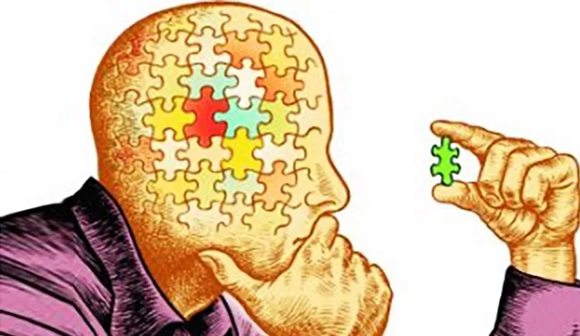
“Sound Judgement”
What does it mean?
Means:
“…as God has allotted to each a measure of faith.” (Romans 12:3)
“We have gifts that differ according to the grace given to us (Romans 12:6)
“each of us is to exercise them accordingly” (Romans 12:6)
Matthew 10:8 “Freely you received, freely give.”
Notes:
Means: ** G=Given ** G=Given..Gifts
**?? It MEAN ?? **
** “EXERCISE …ACCORDINGLY”
MEANS → **FREELY GIVE

Slide 19
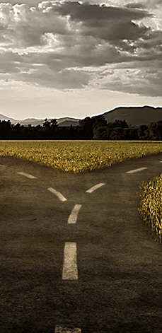
Where to find significance?
By DEMAND:
By God’s GRACE:
“God gave me significance”
“each of us is to exercise them accordingly (serving)”
Differences = Strength
Promoting YOU
I owe YOU
Lasting (worthy)
Loving (serving-based)
“SOUND JUDGMENT”
“I think/know/NEED it…”
Manipulate / SMASH / Cut-Down / Run Away
Differences = Threatening
Promoting ME
YOU owe ME
Temporary (unworthy)
Alienating (Power-Based)
INSANE

Slide 20
3 Questions
What are your gifts?
How are you using them?
Are you significant?
Notes:
b/c Next Week = GOING OVER THE GIFTS

